Slide 1
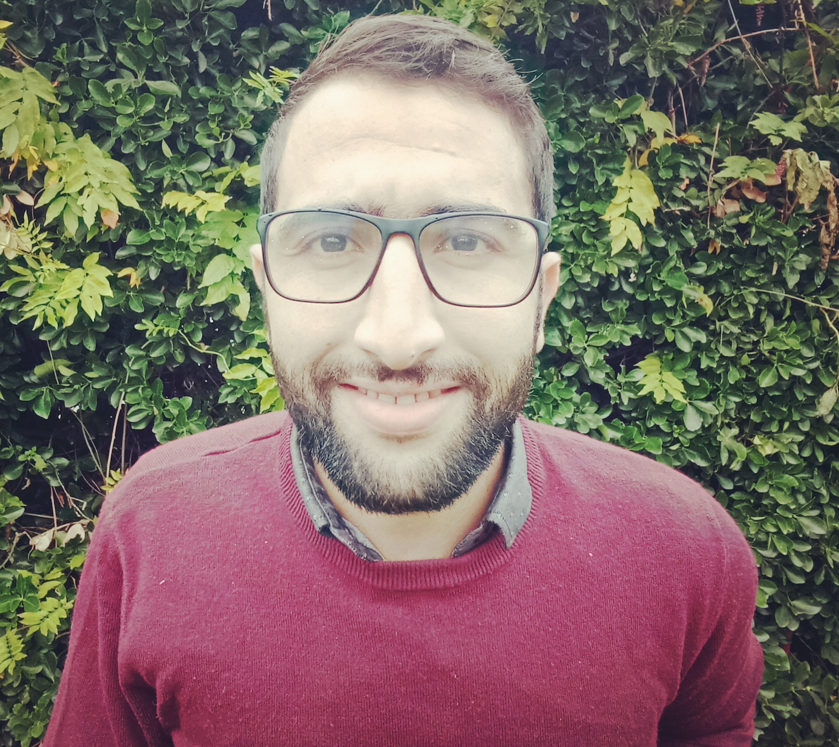
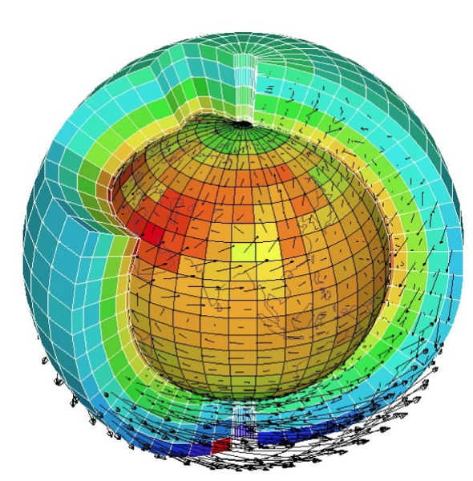
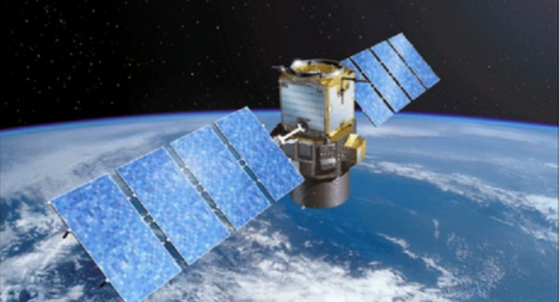
Mohammad EL AABARIBAOUNE
3d Yr PhD student
elaabaribaoune@cerfacs.fr
Towards the assimilation of IASI Level 1 radiances for ozone and aerosols in a chemical transport model
Mohammad El Aabaribaoune¹, Emanuele Emili¹, and Vincent Guidard²
1-CECI, Université de Toulouse, Cerfacs, CNRS, Toulouse, France.
2-﻿CNRM, Université de Toulouse, Météo France, CNRS, Toulouse, France.
IASI 2021 Conference
05-12 December 2021, Evian, France.
RTM: RTTOV
Surface emission
Cloud/rain contribution
O3 and Skin Temperature
Radiances
Surface reflection
Aerosols ?
Aerosols ?
Step 2
Step 1
Step 0

